Slide 1
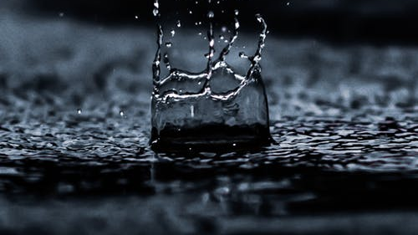
Smart Gujarat For new india hackathon 2019-20 “Varsha Jal Sanchayan"
Team Id : SGH001023
Problem statement:
Rain water harvesting technique of collection of water Using Iot
Problem id : sgh050
Mentored by:
Prof. Jayesh chaudhary

Slide 2
Table of content
Introduction
Global Assessment of Water Statistics
Problem Statement
Expected Outcome
Rain water harvesting
Implementation of IOT
Calculation of efficiency
Flow Diagram
Future Scope
References

Slide 3
introduction
The history, culture, current and future socioeconomic status and environmental sustainability of India and people of urban areas are intricately linked to the water resources which sustain on rain. These water resources can be made available through rain water harvesting , also there is no proper management of the water level at these rain water harvesting tanks against threats like water theft or lack of reusability. An effective Water Level Management system using IoT could help enhance the current scenario and generate a revenue for the people.[1]

Slide 4
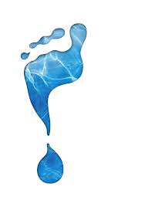
Global Assessment of Water Statistics [2]
A growing number of countries are producing water accounts and implementing the SEEAW(System of Environmental-Economic Accounting for Water). The results of Phase I of the Global Assessment of Environment Statistics2 and Environmental-Economic Accounting in 2006 indicated that 22 countries were compiling water accounts and a further 8 had plans to develop them. At that time the SEEAW existed only in draft form. Two years later, in 2008, when this global assessment was conducted 33 countries were compiling water accounts and a further 11 had plans to implement them in the next two years .
In addition, of the countries that now have water accounts, 20 intend to either improve the quality of the accounts already compiled or to start producing different types of accounts . These are clear indications that the water accounts are relevant for countries and need to strengthen or start the implementation of saving water has been immersed. This is being increasingly recognised.

Slide 5
Problem statement
The rain water harvesting system needs to be designed in a way that it does not occupy large space for collection and recharge system and its efficiency can be monitored. The availability of technique or method to check the efficiency of recharge well and its functioning is not there at present. In present scenario, there is a great need to focus on this issue of water scarcity in urban areas where ground water level is depleting very fast with proper management, policies and monitoring technique to solve this problem. The Problem Solution Must contain the following Points. 1. How much water can be collected in particular area can be estimated by applying the concept of rain water harvesting. 2. What is the collection system efficiency and how it can be checked or monitored. 3. Present latest advancements, application of sensors & IoT in rain water harvesting system and policies in this field

Slide 6
Expected outcomes
Provides self-sufficiency to water supply
Reduces the cost for pumping of groundwater
Reduces soil erosion in urban areas
Rainwater harvesting systems are simple which can be adopted by individuals
Development of technique, method or model to monitor the efficiency.
Application of sensors & IoT for monitoring availability of water in system.

Slide 7
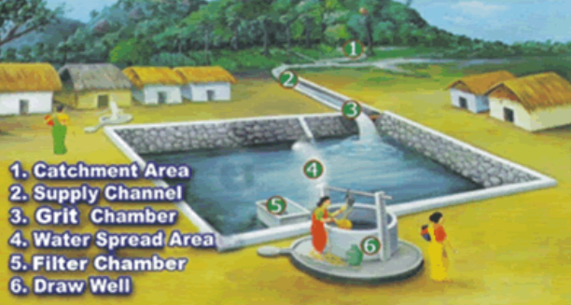
Rainwater Harvesting
A user can harvest rainwater using any of the harvesting method he likes and finds suitable.
After a certain predefined amount of water is collected, quality of water is tested against a set of predefined parameters set by grid administrator.
Motive behind this is to generate a revenue on the basis of harvested water.

Slide 8
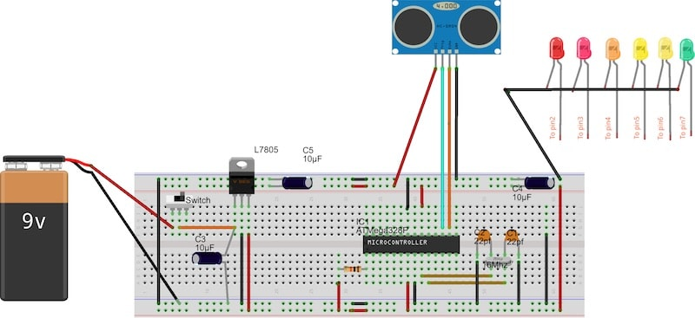
Implementation of IoT[1]
The system uses ultrasonic sensor to determine the level of water in the tank.
Depending on the capacity of the storage, Arduino generates a signal whether to consume the collected water or to move it to storage system.
Water flow sensor will be used in the pipe to calculate the amount of water transmitted to the smart storage.
According to the volume of water transferred credits will be granted to the user in his mobile application.
Also, all the data of all the users will be sent to govt. to calculate efficiency of the system and get the statistics of water.

Slide 9
Calculation of efficiency
The rainfall on a specific terrace will be calculated using the waterflow sensor(Rc) and that data will be sent to database
Also the total rain harvested will be found using the rainfall sensing meter(Rt) and the surface area(S.A.)
Using the mentioned factors we will be able to calculate the efficiency.
Efficiency=Rc/(Rt*S.A.)

Slide 10
Flow Diagram
Rain Water Collected
Calculating Quality Of Water
If Contaminated Then Purify The Water using basic techniques
Move The Data To The Firebase
User can view their respective data via app.
Collect the data regarding quantity and quality
Calculating credit based on volume

Slide 11
Future scope
The data collected can be used by the data scientist for various data analysis projects.
On the basis of data collected we can easily predict the water consumption of future.
Furthermore these details can be used to reduce the effects of draughts

Slide 12
References
Water Level Monitoring and Management of Dams using IoT - DOI: 10.1109/IoT-SIU.2018.8519843
Global Assessment of Water Statistics and Water Accounts Prepared by the United Nations Statistics Division

Slide 13
Thank you

